Slide 1
ALU - STRUCTURAL IMPLEMENTATION
Besleaga Sorin, Al-Yafeai Yosif
Proiectul nostru:
https://github.com/sorykkk/ALU-structural

Slide 2
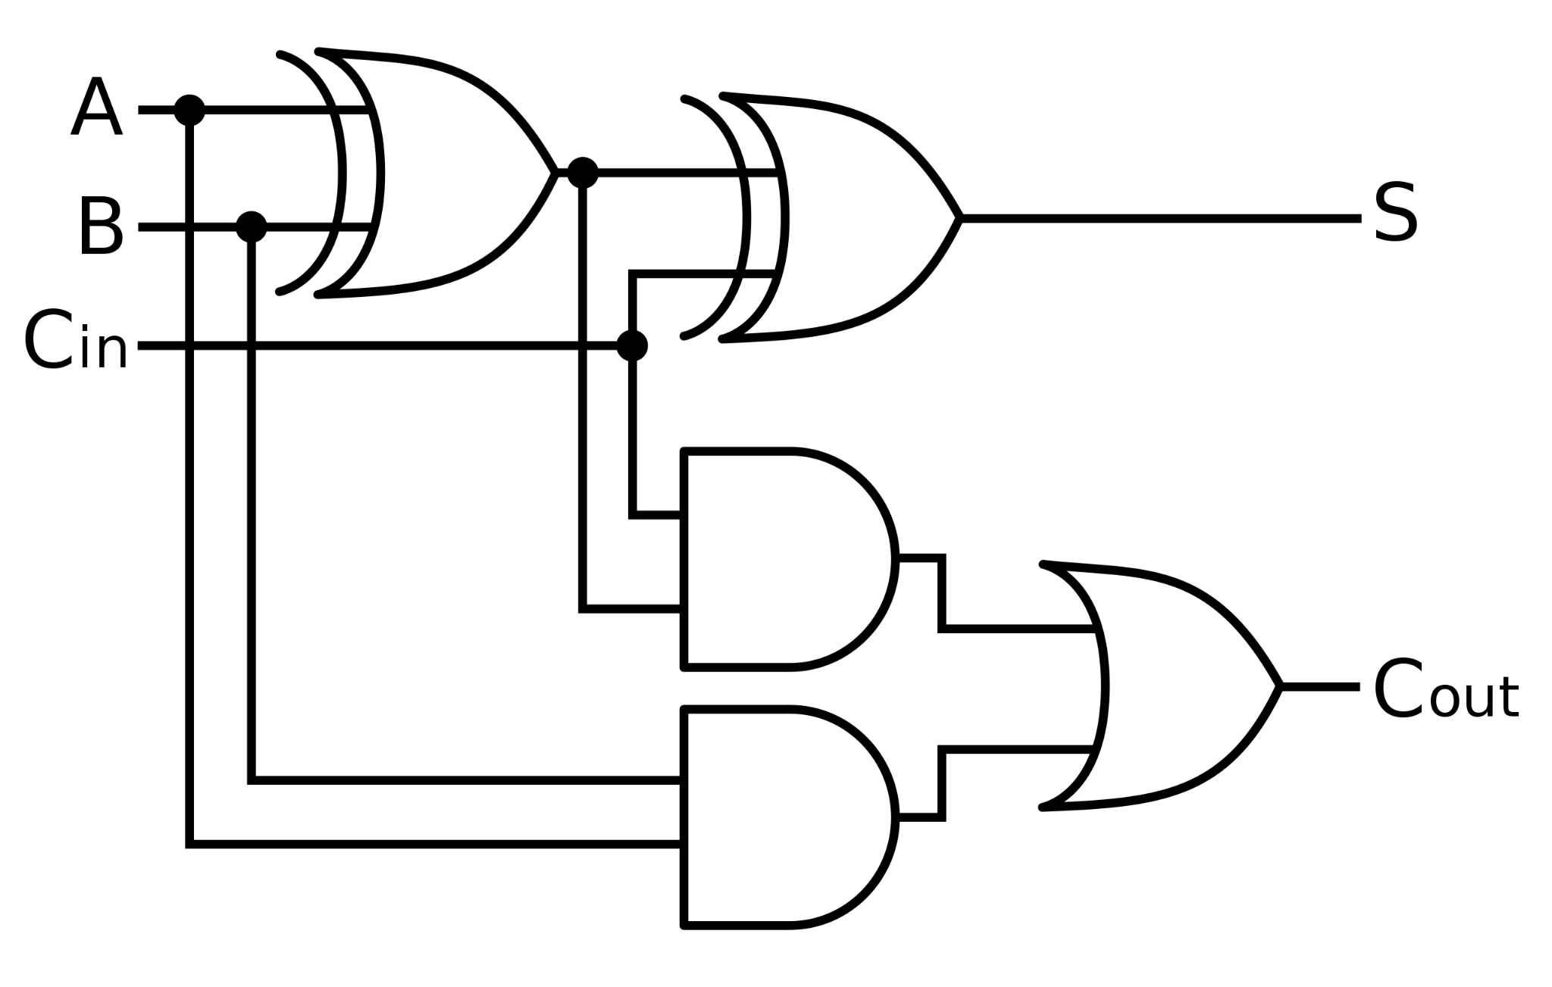
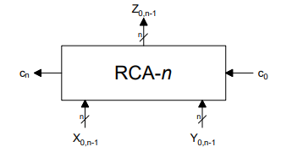
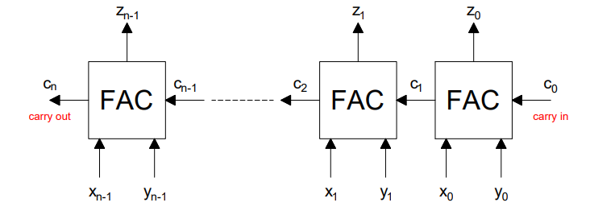
Full-Adder Cell &
Ripple-Carry Adder

Slide 3
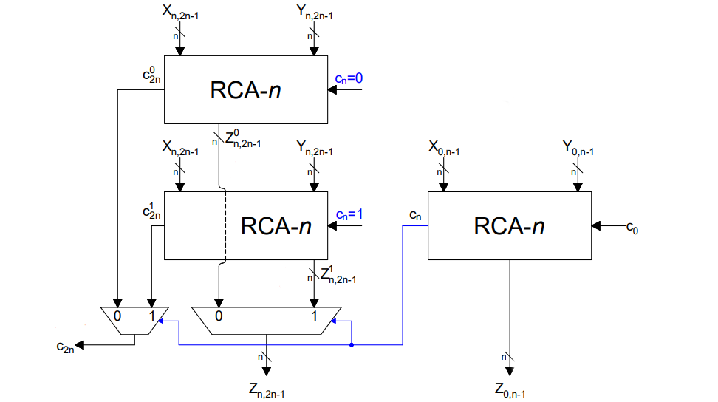
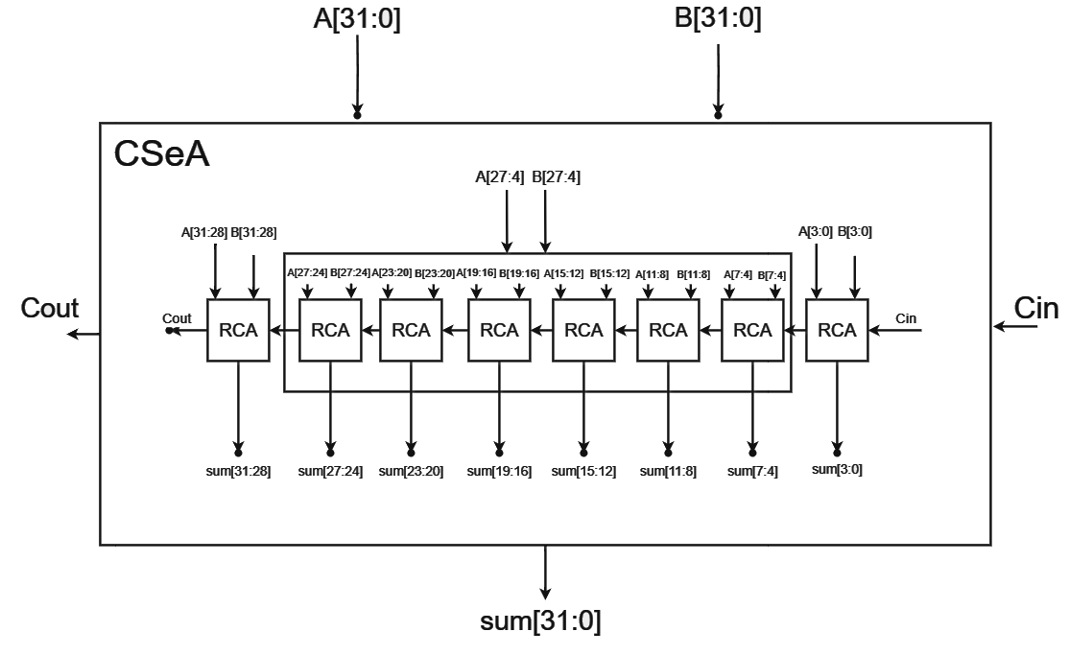
Carry-select adder

Slide 4
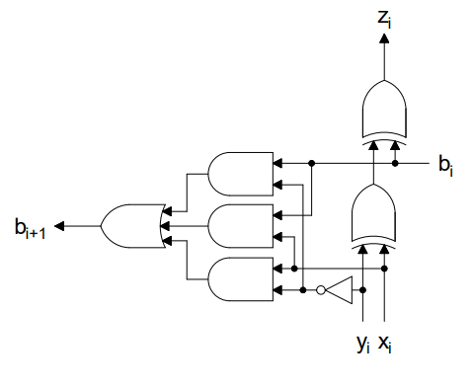
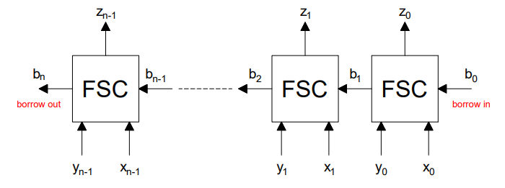
Full Subtractor Cells

Slide 5
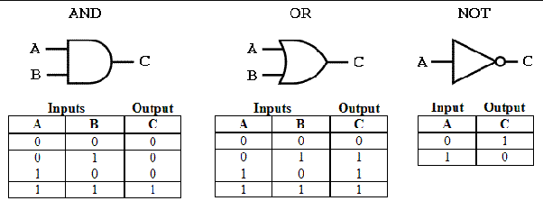
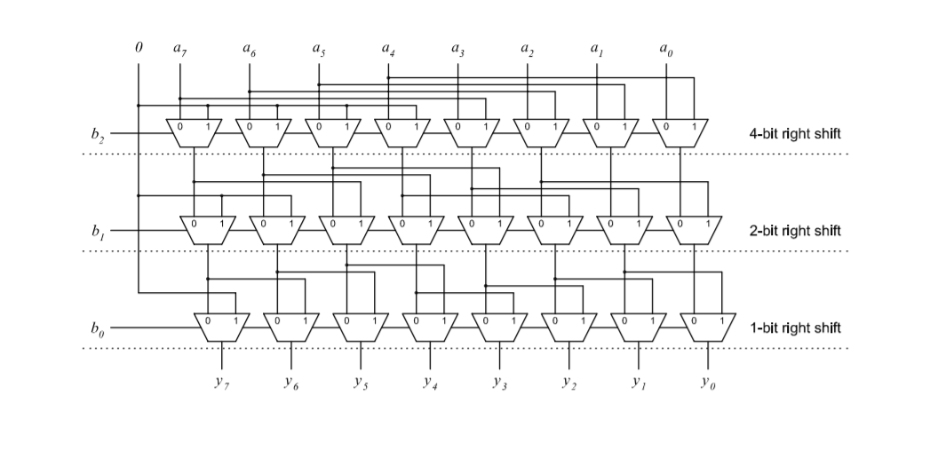
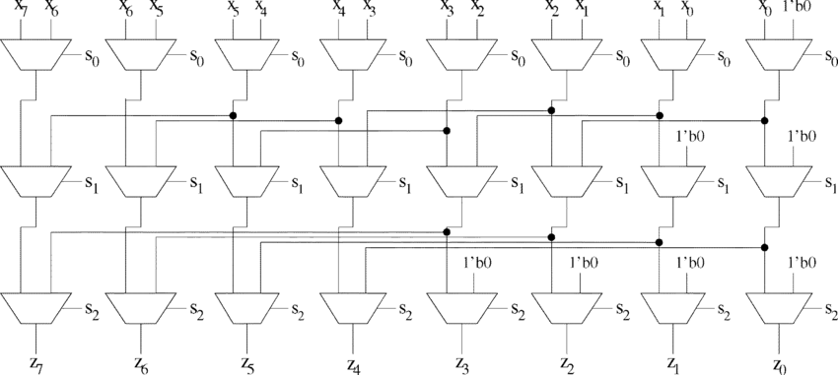
Bitwise Operators

Slide 6
MULTIPLIER - BOOTH RADIX 4

Slide 7
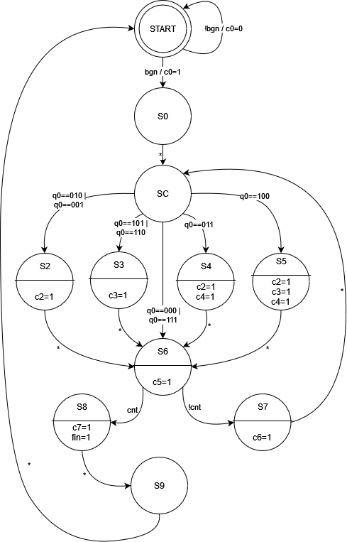
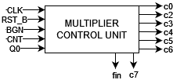
MULTIPLIER CONTROL UNIT FSM
MULTIPLIER CONTROL UNIT

Slide 8
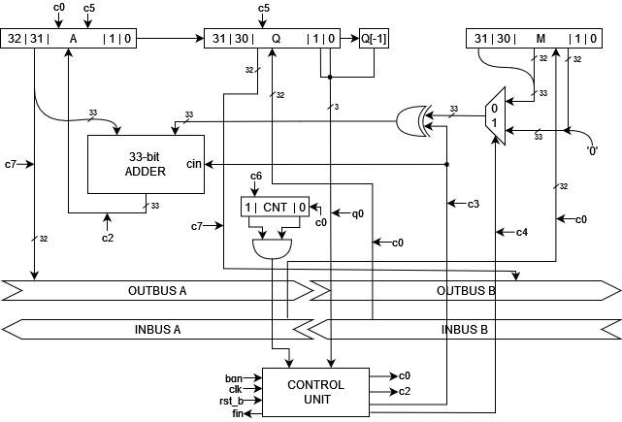
MULTIPLIER ARCHITECTURE

Slide 9
DIVIDER - SRT 2

Slide 10
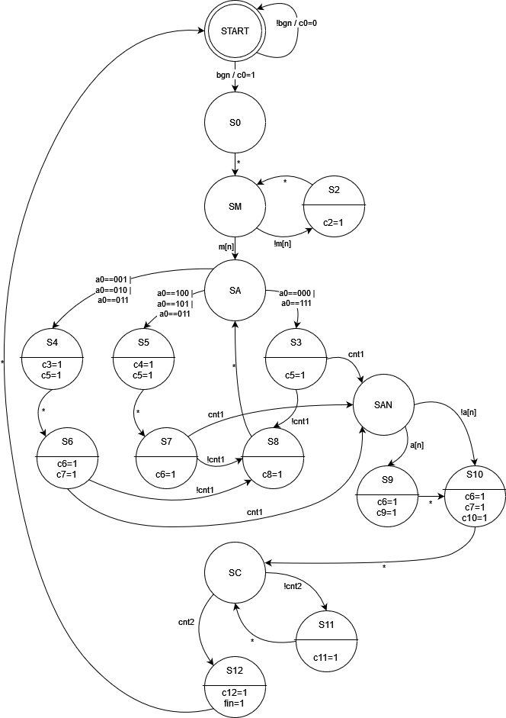
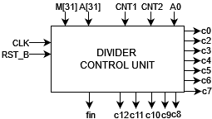
DIVIDER CONTROL UNIT FSM
DIVIDER CONTROL UNIT

Slide 11
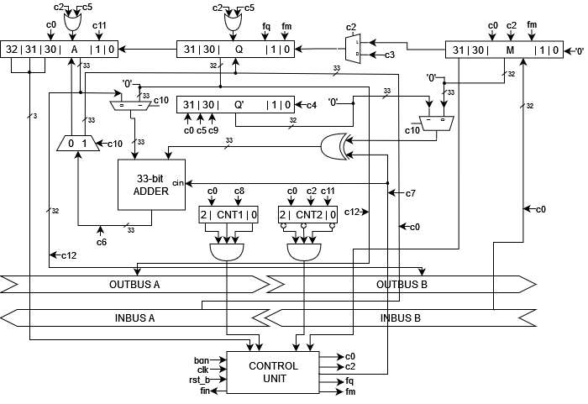
DIVIDER ARCHITECTURE

Slide 12
ALU

Slide 13
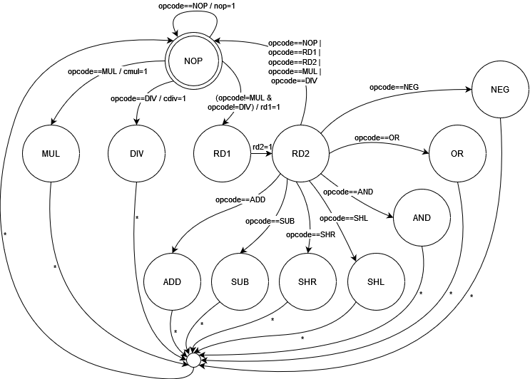
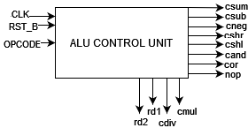
ALU CONTROL UNIT FSM
ALU CONTROL UNIT

Slide 14
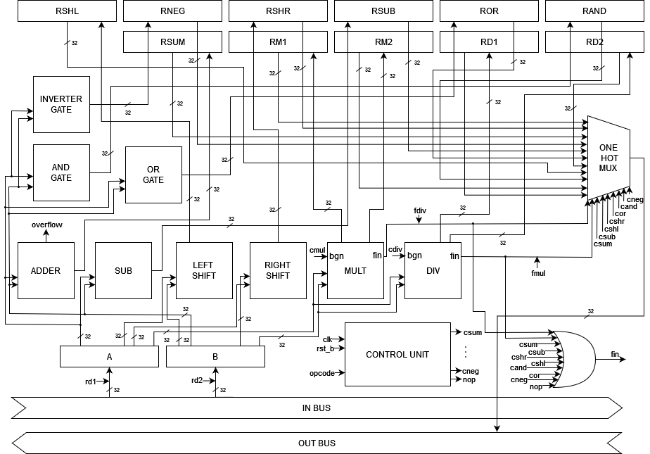
ALU HARDWARE

Slide 15
THANKS!
ANY QUESTIONS?

